Slide 1

C2C E-COMMERCE BUSINESS PERFORMANCE ANALYSIS
Presented By: Femi Babatunde
Mentor: Upom Malik

Slide 2




Background:
Since the pandemic struck in late 2019, the process of buying and selling online has gained traction.
More individuals now make their purchases online.
It is fair to say that e-commerce has been popular before the pandemic started.
It just became more widespread during the pandemic.
Most recently, platforms like Amazon, eBay, Shopify, and WooCommerce have dominated and shaped this area of trade.

Slide 3

The Problem
A C2C company is one that enables users to buy and sell on platforms at the same time. Examples are Amazon and eBay.
This study focused on a fashion C2C e-commerce platform. The company is based in France.
For every e-commerce platform, there are factors like customer retention, churn rate, conversion rate, user activeness that the platform owners must consider.

Slide 4

Problem Cont’d
The following questions were considered in this study:
What factors that contribute to sales?
What is the lifetime value of customers on each platform?
What is the average retention rate and activeness of users?
Does country of residence influence sign ups?

Slide 5
Who might care?
Amazon
eBay
WooCommerce
Shopify
…………E.T.C

Slide 6

Data information
Data was acquired from Kaggle.
Total observation in data frame was 98000 .
Total number of fields in the data frame was 24

Slide 7
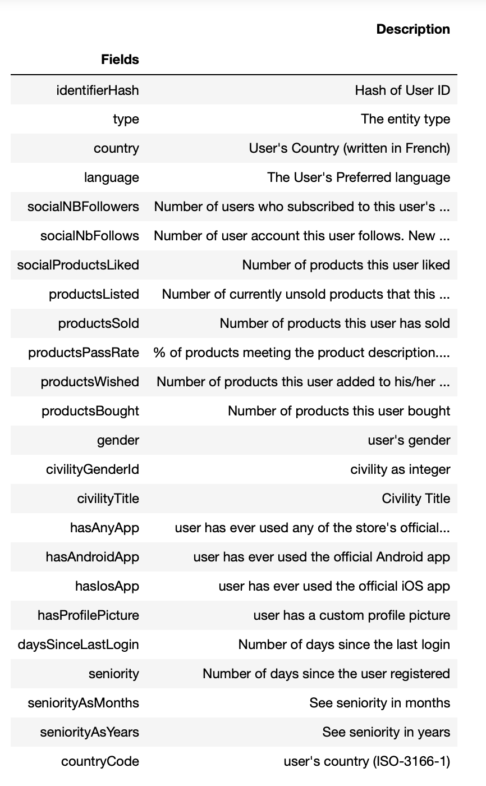

Data Set fields

Slide 8
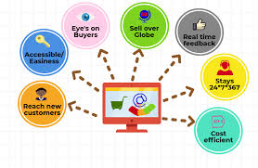
Data wrangling
The data when collected from Kaggle was relatively cleaned but required more work for it to be ready for modeling.
There were categorical variables that needed processing
Country
Gender
civilityTitle
Language
229 features were engineered from the original 24 fields
df = pd.concat([df,pd.get_dummies(df['language'], prefix='lang')],axis=1)

Slide 9
Data wrangling cont’d
Since the C2C platform was majorly in French, an attempt was made to interpret the 98000 observations to English.
Due to the size of the dataset, it took a very long time to complete the interpretation.
As a result, the original language of the dataset was retained .
translator = Translator(to_lang="English", from_lang = "French")
translation1 = translator.translate("Royaume-Uni")
translation1 United Kingdom

Slide 10
Data exploration
Gender distribution
Gender Distribution
Based on the dataset, there were more females in the dataset than male.

Slide 11
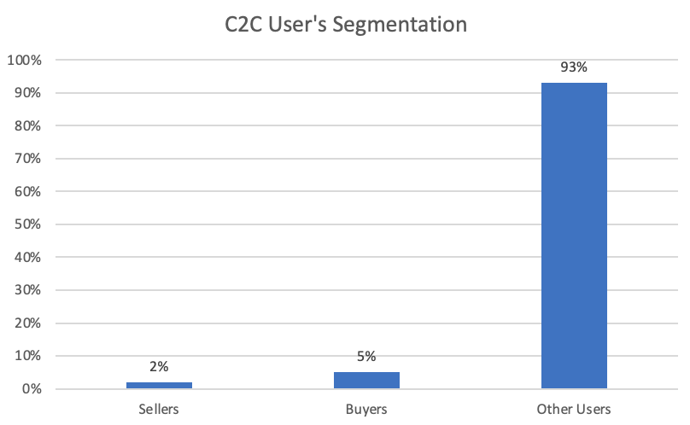
Data exploration CONT’d
User’s Segmentation
2% of dataset were identified as sellers
5% were identified as buyers
93% did not buy anything on platform

Slide 12
Data exploration CONT’d
User’s Segmentation
2% identified as sellers (products sold >=1)
5% identified as buyers (products bought >=1)
93% did not sell or buy anything on platform

Slide 13
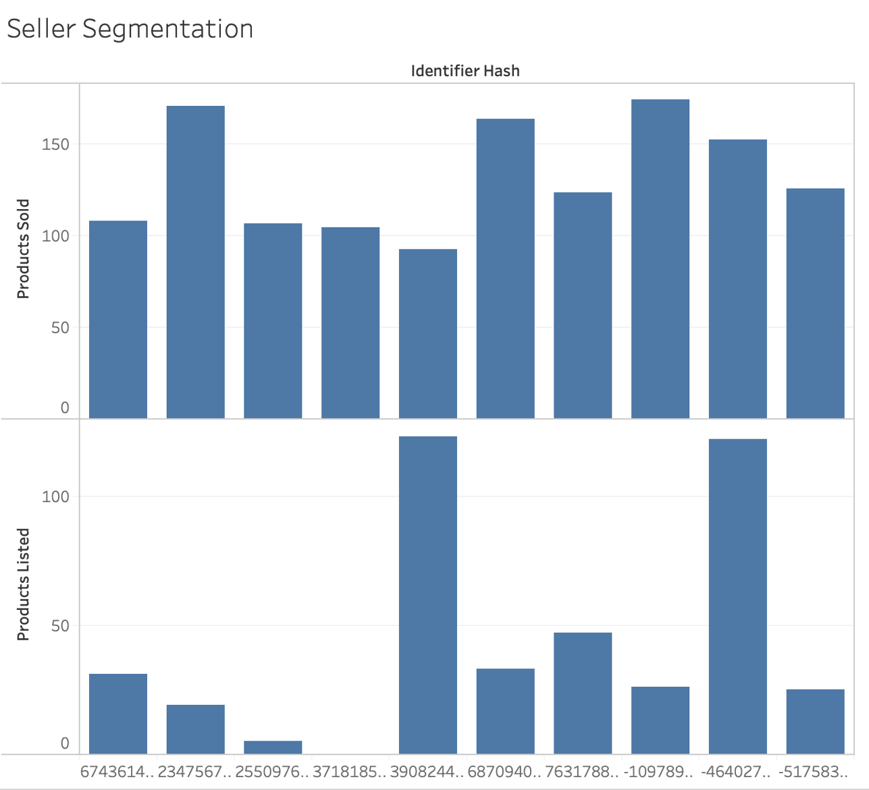
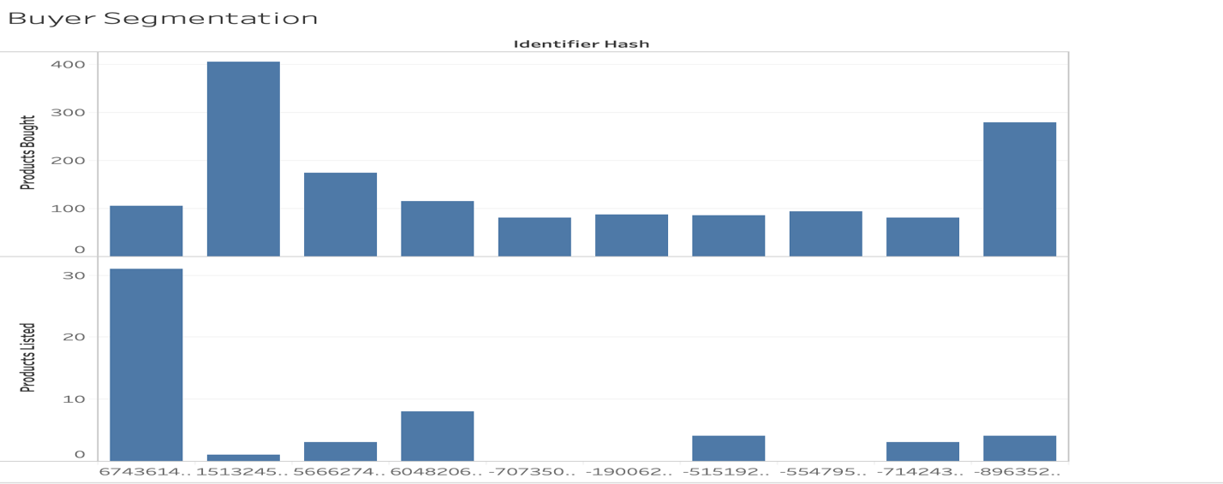
Data exploration cont’d
From the above, some sellers and buyers had products listed on the platform. 7 of the top 10 buyers had products listed. One of the top buyers was also a top seller.

Slide 14
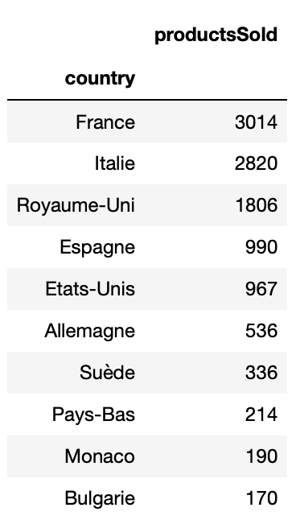
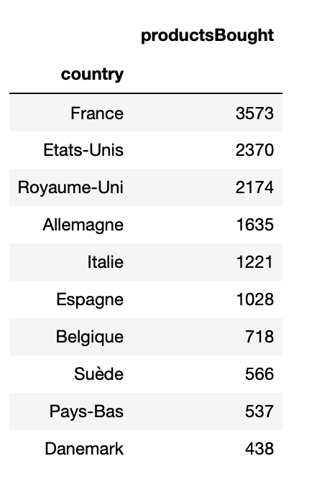
Data exploration cont’d
France ranked highest as expected for both sellers and buyers. The USA (N. America) was part of the top 5 for the 2 segments. Besides the USA, other countries in the top 10 were European.

Slide 15
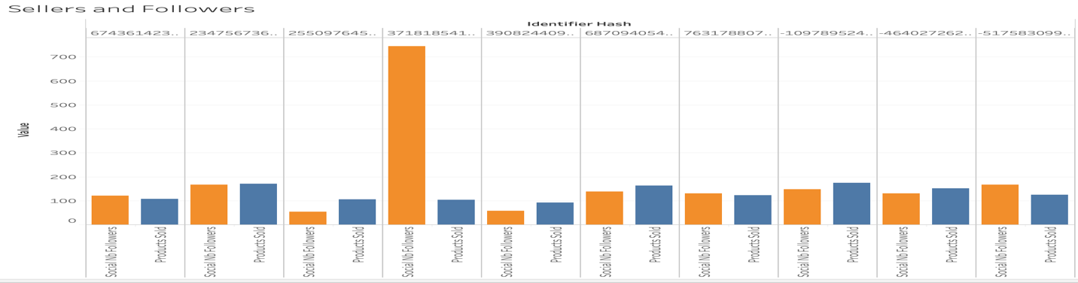
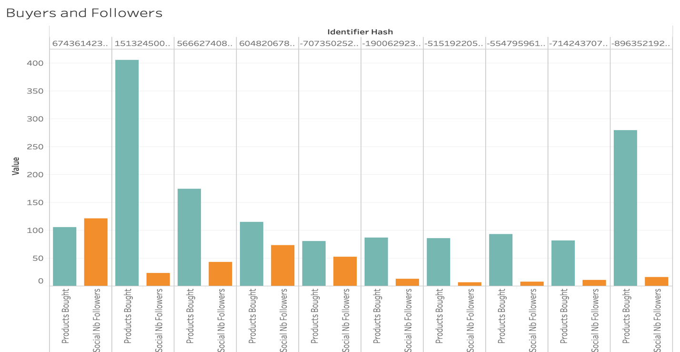
Data exploration cont’d
Top sellers and buyers have strong followership on the platform. The user with the highest number of followers (744), sold 104 products on the platform. The user with most purchases followed only 8 other users

Slide 16
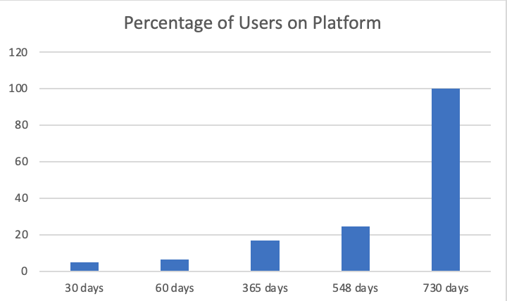
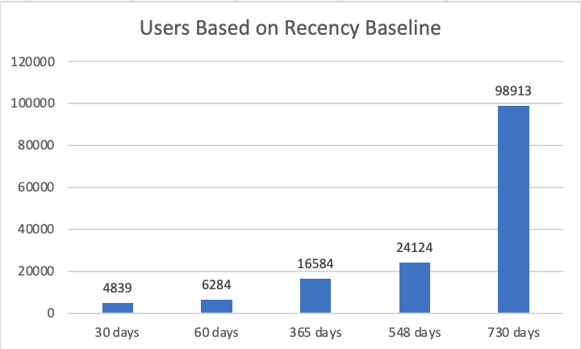
Data exploration cont’d
5% of the total users were on the platform within 30 days before the data was pulled. A year just before the data was pulled, 17% (16,584) of the users were active on the platform.

Slide 17
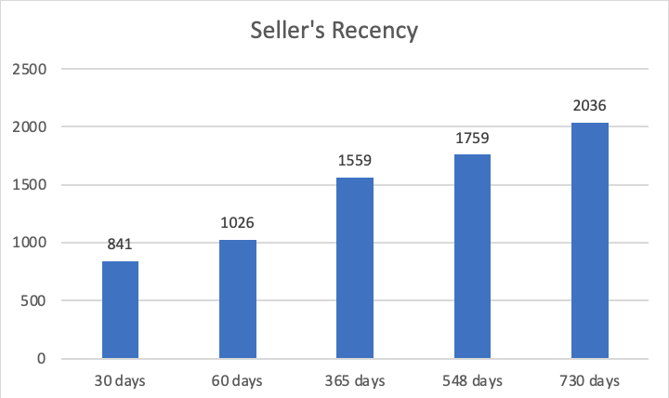
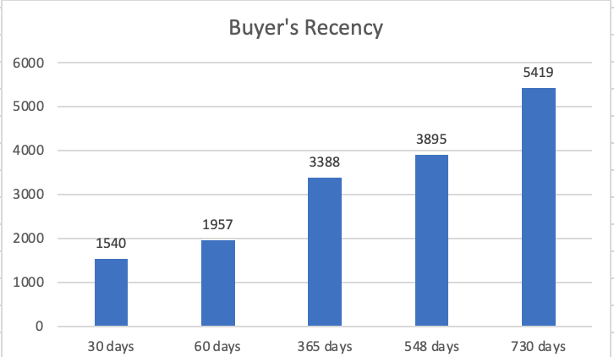
Data exploration cont’d
On average, sellers as expected were more frequent on the platform than buyers. Sellers last login average was 6 months and buyers’ was 10 months.

Slide 18
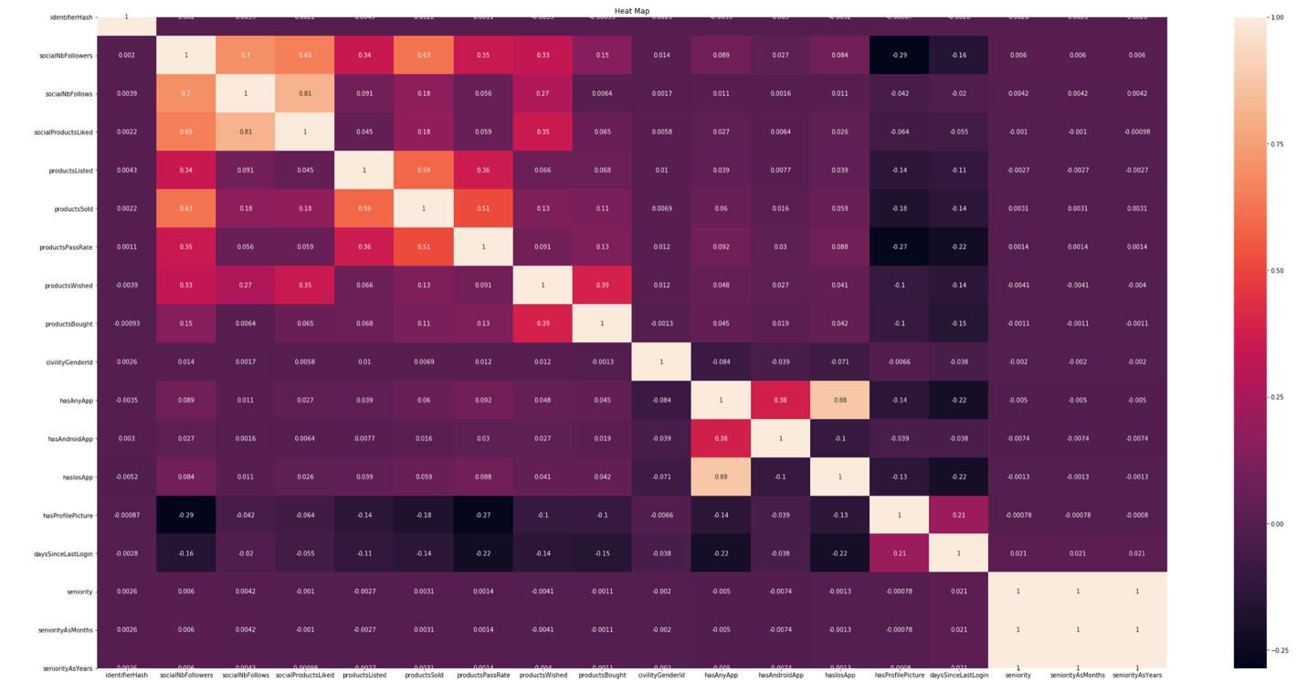
Heatmap analysis
ProductsSold had strong relationship with SocialNbfollowers, productsListed, and productsPassRate in this decreasing order.
ProductsBought got the strongest correlation with productsWished. productsBought showed weak prostive relationships with productspassRate and socialNbFollowers.
SeniorityAsMonth and SeniorityAsYears were dropped from the dataset due to collinearity with seniority.

Slide 19
Dealing with outliers
Outliers were noticed on the dataset, but due to the sizes of buyers and sellers being 2% and 5% of the data frame respectively, decision was made not to drop these outliers.
Dropping the outliers would have drastically affected important observations in the dataset

Slide 20
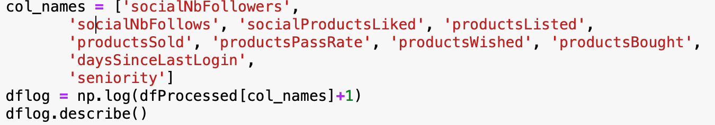
DATA PROCESSING
The data processing step involved the normalization of the dataset as good number of the variables were skewed to the right. The normalization was equally necessary as it was required for standardization of the data frame.

Slide 21

MACHINE LEARNING MODELING

Slide 22
Model overview
Type: Supervised Learning
Regression:
Label1: Products Sold (Proxy for sellers)
Label2: Products Bought (Proxy for buyers)
Dataset split:
Train set: 75%
Test set: 25%
Tool: Sklearn

Slide 23
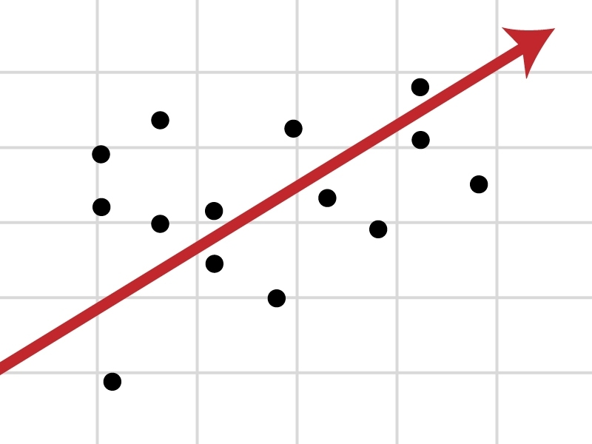
regression algorithm used
Multiple Linear Regression (MLR)
Lasso Regression (L1)
AdaBoost Regression (AR)
Gradient Boost Regression (GBR)
XGBoost Regression (XGBR)

Slide 24
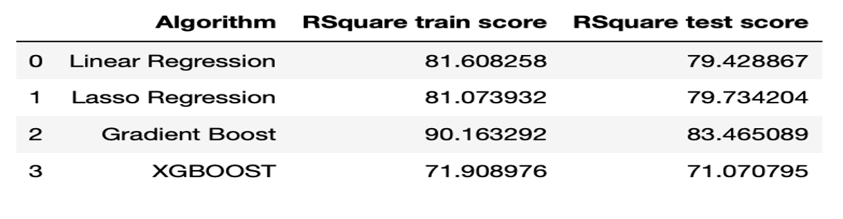
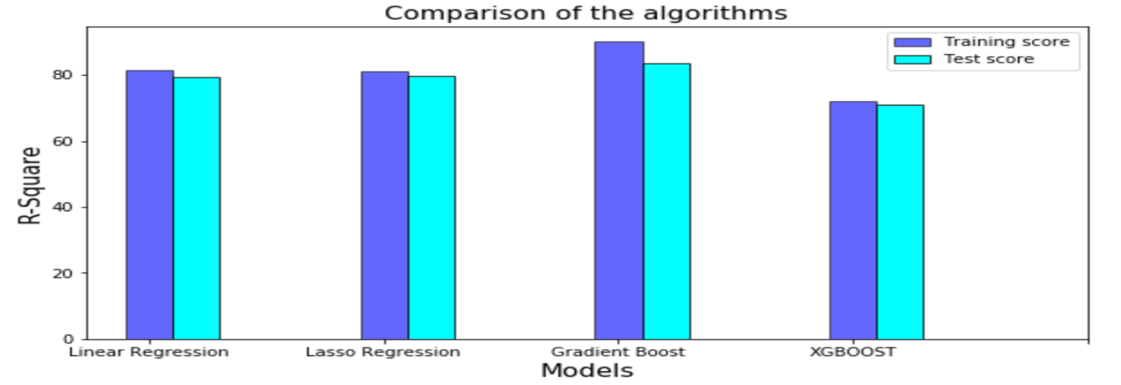
Algorithm performance
Seller’s Prediction
Going by the table and figure above comparing the models, GradientBoost was the best performing model.

Slide 25
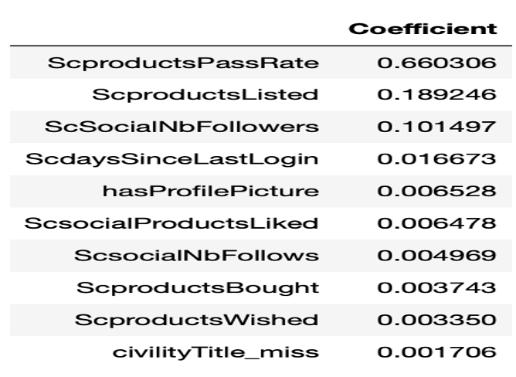
Important features of model
Seller’s Prediction
Most important feature of the model:
Products Pass Rate: sellers with high pass rate of products have high tendencies to sell more.
Products Listed: the higher the number of products listed; the higher chance sellers have of making sales
Number of Follower: The model also confirmed that social media interaction with users have high impact on number of products sold by sellers

Slide 26
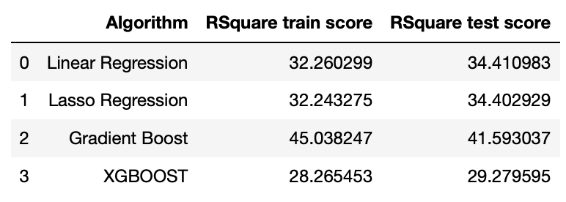
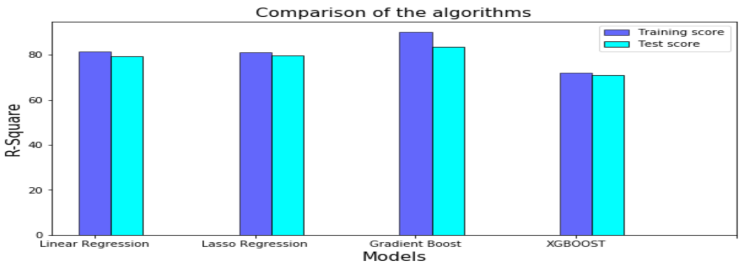
Algorithm performance
Buyer’s Prediction
Going by the table and figure above comparing the models, GradientBoost was the best performing model.
Model predictions by the algorithms were very low.
Culprit: features

Slide 27
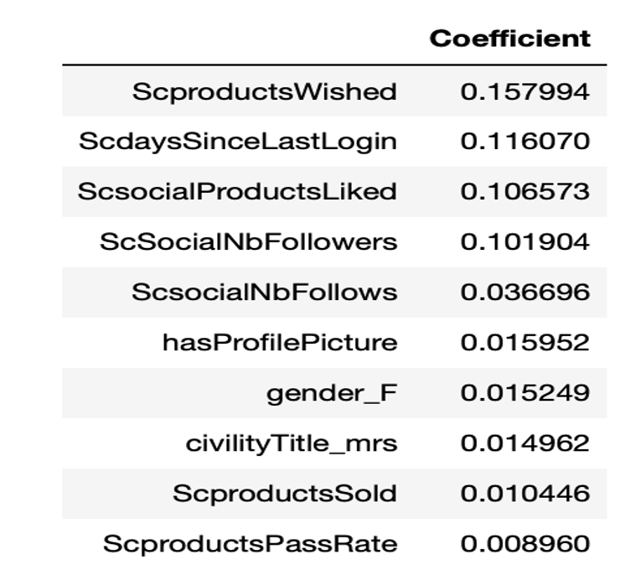
Important features of model
Buyer’s Prediction
Most important feature of the model:
Products Wished: users will most likely complete a purchase if such product is on a wish list
Recency: If a user frequent the platform, such user will likely make purchase
Number of Follower: The model also confirmed that social media interaction with other users have high impact on number of products the user will purchase
Females have high chance of making purchases on the platform

Slide 28
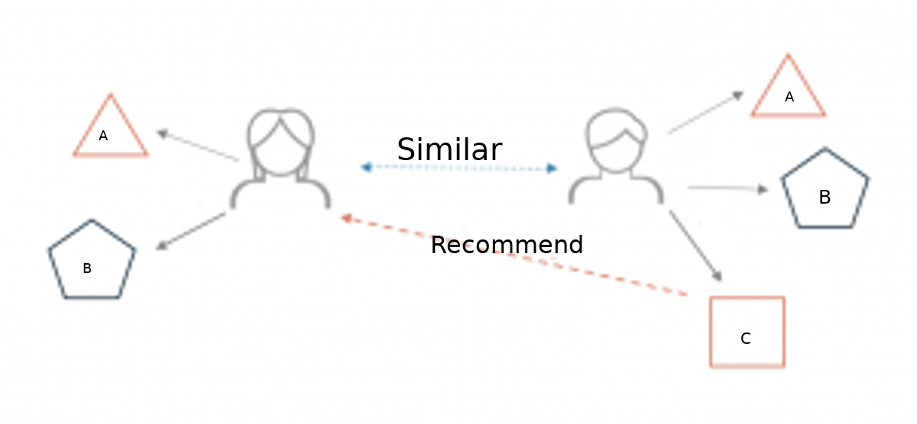
IDEA FOR FUTURE RESEARCH
Predicting retention and churn rates of users on the platform.
Estimating RFM (recency, frequency and monetary value).
Design of recommendation system for both buyers and sellers in terms of best-selling products

Slide 29
recommendations
This study will be useful to e-commerce businesses like amazon, ebay, shopify and woocomerce as they can design their platforms in ways to ensure that both buyers and sellers are well satisfied with their shopping experiences on the platform.
Social media integration with e-commerce will go a long way to influence purchases.
E-commerce platform designers/ developers will need to ensure that quality control mechanism is embedded on the platform. This will drive retention on the platform.

Slide 30
Thank you!!!

